Slide 1

Zatt
A Python implementation of the Raft algorithm for distributed consensus

Slide 2
The Consensus Problem
Agree on a shared state in a distributed system in the presence of faulty processes
Notes:
Condividere uno stato, replicato consistentemente, nonostante Errori, guasti, o partizioni di rete,
Fault-tolerant
Replicated
Consistent
Available

Slide 3
Raft Overview
Clients
Server 2 - Follower
Server 1 - Leader
Server 3 - Follower
Notes:
La visione di insieme del sistema
Lo stato è un dizionario di python

Slide 4
Raft Overview: State Machine Replication
Consensus
Subsystem
State
Machine
Log
Dictionary
x=9
x | 9
y | 5
z | 1
z=1
x=3
y=5
x=2
State machines on a cluster of servers compute identical copies of the state
A replicated log stores commands for the state machine on all servers
Used to solve fault tolerance problems
It ensures
Safety
Availability
Typical use cases:
Store configurations
Leader election in large scale systems
Distributed lock managers
Notes:
In generale ogni nodo del cluster si compone come segue
monotono
Quindi il problema si traduce nel fare si che il log sia coerente

Slide 5
Raft Overview: Election
Start
Discover node with
higher term
Follower
Leader
Heartbeat
Timeout
Voted by
Majority
Discover
Existing leader
Candidate
Election
Timeout

Slide 6
Raft: Leader Election
F₁
F₁
F₁
Notes:
Raft si compone si due sottosistemi, quello più innovativo
di cui vi parlerò brevemente è quello per l’elezione del leader
Che utilizza i timer randomizzati

Slide 7
Raft: Leader Election
F₁
F₁
F₁

Slide 8
Raft: Leader Election
F₁
Vote request
C₂
Vote request
F₁

Slide 9
Raft: Leader Election
C₁
Response
Success
C₂
Response
Success
F₂

Slide 10
Raft: Leader Election
F₂
Heartbeat
L₂
Heartbeat
F₂
Notes:
A questo punto il leader procede a mandare degli heartbeat regolari per mantenersi in controllo del cluster

Slide 11
Implementation: Zatt
Notes:
Scritto da zero

Slide 12
Zatt: Client
Client 1
Client 2
$ python3
Python 3.6.1 on linux
>>> import zatt.client
>>> d = zatt.client.DistributedDict('node1.mycluster.io')
>>> d['hello'] = 'world'
>>>
>>>
>>> d
{'hello': 'mars'}
$ python3
Python 3.6.1 on linux
>>> import zatt.client
>>> d = zatt.client.DistributedDict('node1.mycluster.io')
>>>
>>> d
{'hello': 'world'}
>>> d['hello'] = 'mars'

Slide 13
Zatt: Server: Architecture
Leader
Log
Candidate
Orchestrator
Log manager
State Machine
Follower
Client Protocol
Peer Protocol
Compactor

Slide 14
Zatt: Architectural choices: Concurrency
Multiprocessing
Independent i/o scheduling
No GIL
Isolation
Message passing
Slow spawn
Multithreading
Shared i/o scheduling
GIL
Lightweight
Sync primitives necessary
Twisted
Green threads
Time proven
Python2 only
Overkill
Asyncio
Green threads
Cheap context switching
stdlib
Non blocking i/o
No Sync primitives
Notes:
The GIL issue
In threading the context switches are arbitrary, in greenlets they are program defined
Scheduling definito da python

Slide 15
Zatt: Architectural choices: Serialization
 | JSON | MsgPack | Cap’NProto | ProtoBuffer | FlatBuffer
Encoding | text | binary | binary | binary | binary
Append to Array | ⨯ | ✓ | ✓ | ⨯ | ⨯
Schema | ⨯ | ⨯ | ✓ | ✓ | ✓
Stream de/serialization | ⨯ | ✓ | ✓ | ⨯ | ✓
Mutable state | ✓ | ✓ | ⨯ | ⨯ | ⨯
Present in PyPi | ✓ | ✓ | ✓ | ⨯ | ⨯
Zero copy | ⨯ | ⨯ | ✓ | ⨯ | ✓
Notes:
Necessaria per client, cluster, disk
Also GRPC!
Fast in memory manipulation

Slide 16
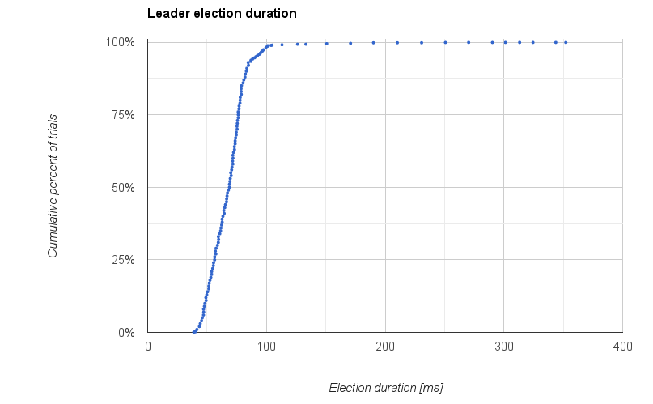
Zatt Performance: Election Speed
Setup
Leader removed in stable cluster
Cluster
5 AWS m4.large
<4ms ping
Results
1000 trials
87% of elections under 80ms
98% under 100ms
Notes:
Cluster of 5 was setup on the AWS platform, where the latency between each pair of machines was lower than 4ms.
In a benchmark with 1000 trials, 87% of the elections terminated in under 80ms, 98% terminated in under 100ms and very few trials were in the hundreds of ms region

Slide 17


Zatt Performance: Distributed testing
Setup
Used for performance evaluation
Implemented with docker containers
6 Servers
C2L
Intel C2750
2.4 GHz
32 GB ram
5 Gbps NIC
64 Clients
C1
ARMv7
2.4 GHz
3 GB ram
1 Gbps NIC
2 Each
M4.large
Xeon E5-2666v3
2.6 GHz
32 GB ram
1 Gbps NIC

Slide 18
Zatt Performance: Distributed testing
Servers | Clients | Workers | Entries | size[B] | time[s] | req/s | Leader Throughput [KB/s]
2 | 4 | 256 | 1000 | 1000 | 10.94 | 91 | 91.4
2 | 4 | 256 | 5000 | 1000 | 15.22 | 657 | 656.9
2 | 4 | 256 | 10000 | 1000 | 32.01 | 312 | 312.4
2 | 4 | 100 | 5000 | 1000 | 11.85 | 422 | 421.8
2 | 4 | 100 | 5000 | 100 | 4.17 | 1200 | 120.0
2 | 2 | 100 | 5000 | 100 | 3.13 | 1597 | 159.75
2 | 2 | 100 | 10000 | 100 | 8.53 | 1425 | 424.95

Slide 19
Zatt: The real world
30+
15+
180
stars
forks
clones

Slide 20
Zatt: Future work
UDP datagram limit workaround
gRPC intracluster protocol
Unit tests
Linearizable semantics
Clients in multiple languages
Observables / callbacks
Notes:
Linear: unique id to client requests
Others: crypto, chaos monkey

Slide 21
Questions?
Notes:
Pluggable, different state machine

Slide 22
Zatt Performance: local testing
Setup
Used for profiling, regression testing
Implemented with multiprocessing.Pool
Performed on laptop
Intel i7-4600U @ 2.10GHz
8GB of DDR3 RAM @ 1600Mhz
Results
Max throughput: 200 req/s
3 server instances
Peak client throughput: 64 clients
A single client can dispatch max 100 req/s

Slide 23
Invariants
Designed for understandability
Separate
leader election
log replication
membership changes
Strong leadership
Just two RPCs
Tested with user studies
Formally specified and proved
Real world usage
CoreOS/Etcd
RethinkDB
Hashicorp/Terraform
Election Safety
Leader Append-only
Leader completeness
Log matching - inductive
Informally proven
State machine safety
Formally proven
Notes:
Election Safety: at most one leader can be elected in a given term.
Leader Append-Only: a leader never overwrites or deletes entries in its log; it only appends new entries.
Log Matching: if two logs contain an entry with the same index and term, then the logs are identical in all entries up through the given index.
Leader Completeness: if a log entry is committed in a given term, then that entry will be present in the logs of the leaders for all higher-numbered terms.
State Machine Safety: if a server has applied a log entry at a given index to its state machine, no other server will ever apply a different log entry for the same index.

Slide 24
Zatt: Architectural choices: Networking
Intra cluster
Uses UDP
Fast
Acknowledgement
Retransmission
No need for encryption
Client-Server
Uses TCP
Safe
Stateful
Supports TLS

Slide 25
Zatt: Architectural choices: Client
Refresh Policies
Always
On every read
Lock
Toggled by application
Count
After n reads
Time
After a given datetime.timedelta
Notes:
Compatible with both python 2 and 3

Slide 26
Raft: Log replication
F₂
L₂
F₂

Slide 27
Raft: Log replication
F₂
1 | X ← 2
L₂
F₂

Slide 28
Raft: Log replication
1 | X ← 2
F₂
Append Entry
1 | X ← 2
L₂
Append Entry
1 | X ← 2
F₂

Slide 29
Raft: Log replication
1 | X ← 2
F₂
Success
1 | X ← 2
L₂
Success
1 | X ← 2
F₂

Slide 30
Raft: Log replication
1 | X ← 2
F₂
Append Entry
1 | X ← 2
L₂
Append Entry
1 | X ← 2
F₂

Slide 31
Raft: Network Partition
1 | x ← 2
F₂
1 | x ← 2
L₂
1 | x ← 2
F₂

Slide 32
Raft: Network Partition
1 | x ← 2
F₂
1 | x ← 2
2 | y ← 3
L₂
1 | x ← 2
F₂

Slide 33
Raft: Network Partition
1 | x ← 2
C₃
1 | x ← 2
2 | y ← 3
L₂
Vote
Request
1 | x ← 2
F₂

Slide 34
Raft: Network Partition
1 | x ← 2
L₃
1 | x ← 2
2 | y ← 3
L₂
Success
1 | x ← 2
F₂

Slide 35
Raft: Network Partition
1 | x ← 2
2 | y ← 5
L₃
1 | x ← 2
2 | y ← 3
L₂
1 | x ← 2
F₂

Slide 36
Raft: Network Partition
1 | x ← 2
2 | y ← 5
L₃
1 | x ← 2
2 | y ← 3
L₂
Append
1 | x ← 2
2 | y ← 5
F₃

Slide 37
Raft: Network Partition
1 | x ← 2
2 | y ← 5
L₃
Append
1 | x ← 2
2 | y ← 3
L₂
Append
1 | x ← 2
2 | y ← 5
F₃

Slide 38
Raft: Network Partition
1 | x ← 2
2 | y ← 5
L₃
Append
1 | x ← 2
F₃
Append
1 | x ← 2
2 | y ← 5
F₃

Slide 39
Raft: Network Partition
1 | x ← 2
2 | y ← 5
L₃
Append
1 | x ← 2
2 | y ← 5
F₃
Append
1 | x ← 2
2 | y ← 5
F₃

